Slide 1
PHPMyAdmin

Slide 2
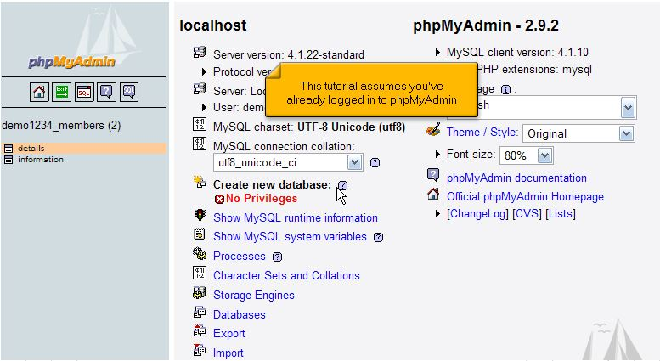
Familiarizing yourself with phpMyAdmin
This lecture assumes that you have already logged in to phpMyAdmin.
Now let’s familiarize ourselves with MySQL database and phpMyAdmin.

Slide 3
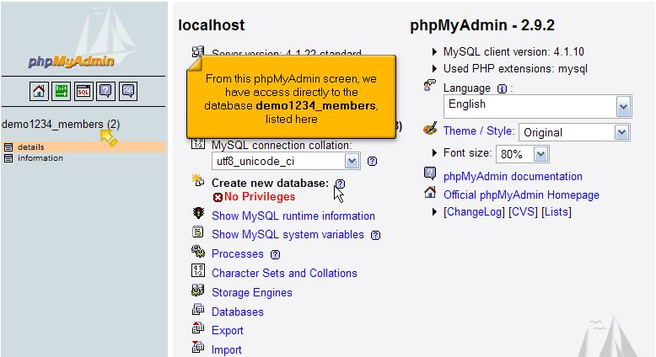
Familiarizing yourself with phpMyAdmin
From this phpMyAdmin screen, we have access directly to database demo123_members listed her.

Slide 4
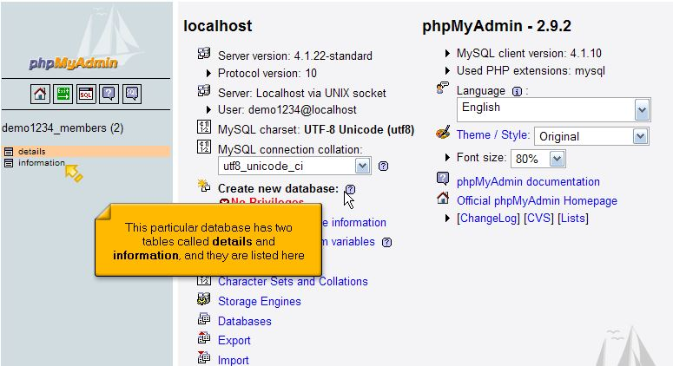
Familiarizing yourself with phpMyAdmin
This particular database has two tables called details and information, and they are listed her.

Slide 5
Familiarizing yourself with phpMyAdmin
This particular database has two tables called details and information, and they are listed her.

Slide 6
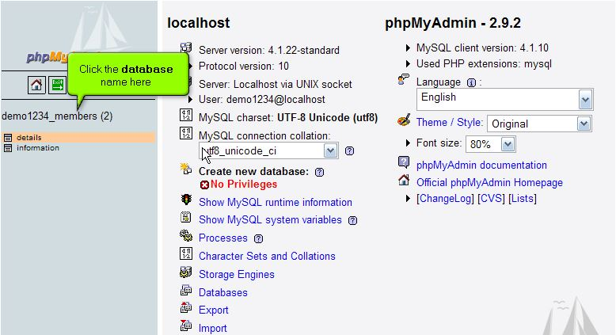
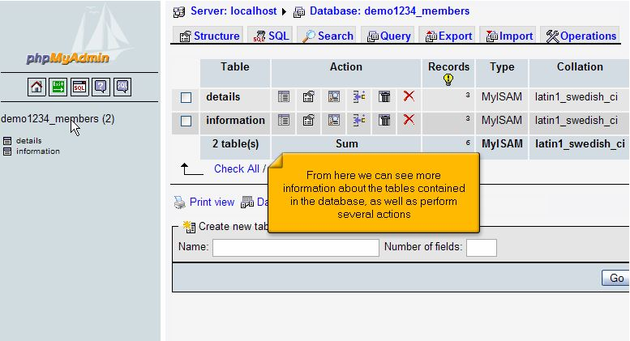
Familiarizing yourself with phpMyAdmin
To show all tables click the database name.
From here we can see more information about the tables contained in the database as well as perform several actions.
1
2

Slide 7
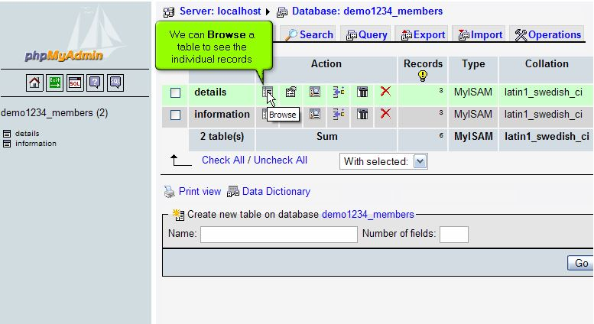
Familiarizing yourself with phpMyAdmin
Browse: we can Browse a table to see the individual records

Slide 8
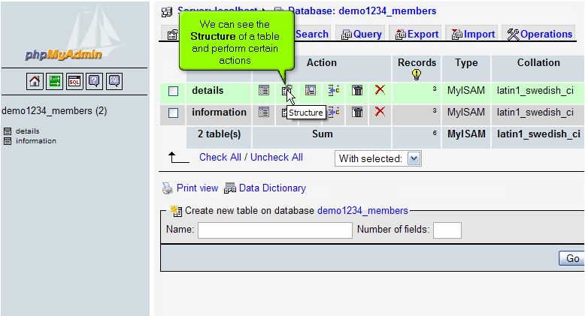
Familiarizing yourself with phpMyAdmin
Structure: we can see the Structure of a table and perform certain actions.

Slide 9
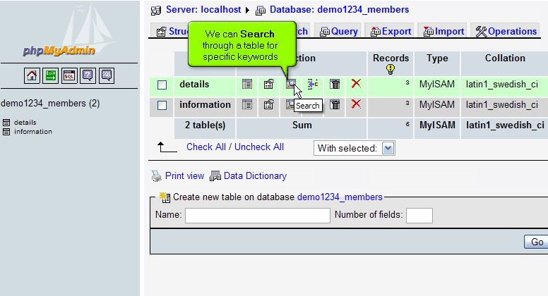
Familiarizing yourself with phpMyAdmin
Search: we can Search through a table for specific keywords

Slide 10
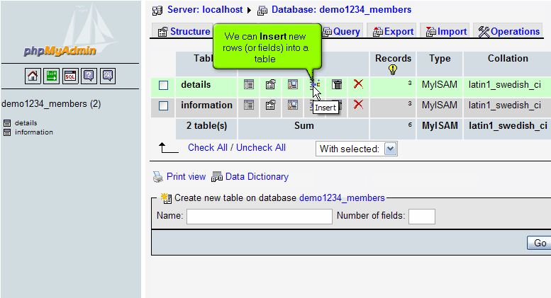
Familiarizing yourself with phpMyAdmin
Insert: we can insert new rows (or field) into a table.

Slide 11
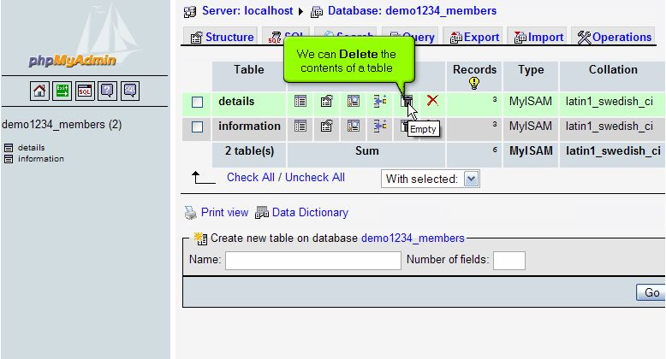
Familiarizing yourself with phpMyAdmin
Empty: we can Delete the contents of a table.

Slide 12
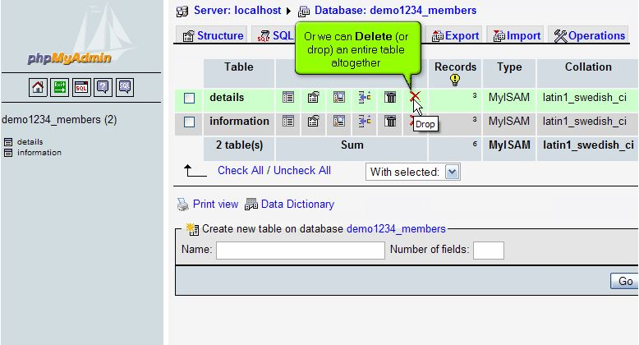
Familiarizing yourself with phpMyAdmin
Drop: we can Delete (or drop) an entire table altogether.

Slide 13
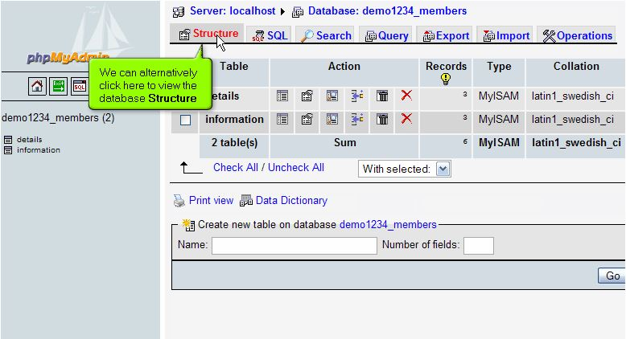
Familiarizing yourself with phpMyAdmin
We can alternatively click on this link to view the database Structure

Slide 14
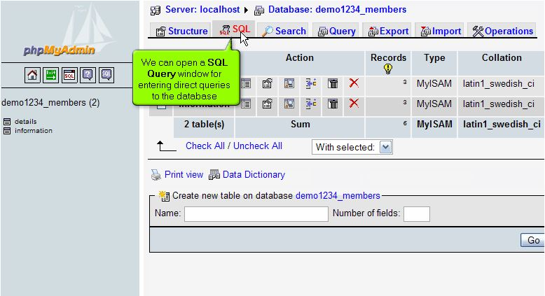
Familiarizing yourself with phpMyAdmin
SQL Query Window: we can open a SQL Query window for entering direct queries to the database.

Slide 15
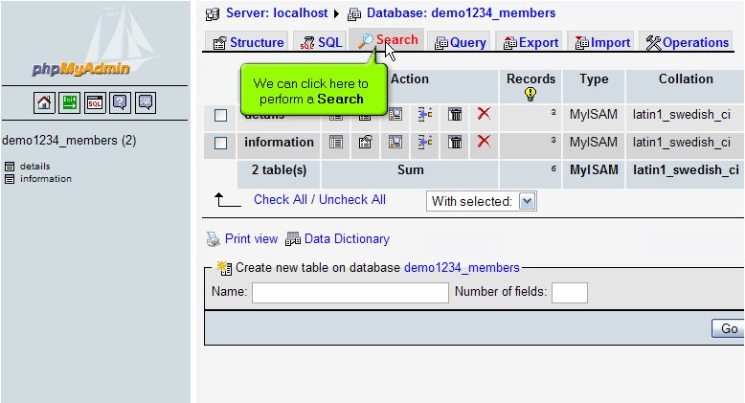
Familiarizing yourself with phpMyAdmin
We can click on this link to perform Search.

Slide 16
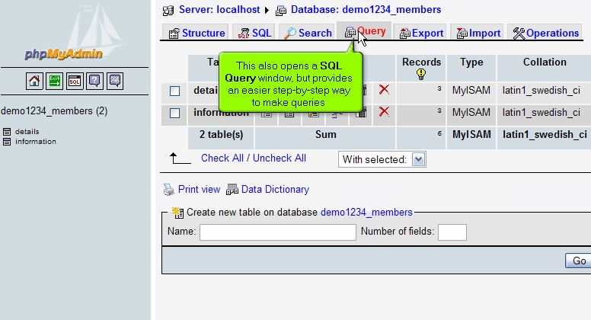
Familiarizing yourself with phpMyAdmin
This also opens a SQL Query window, but provides an easier step-by-step way to make queries.

Slide 17
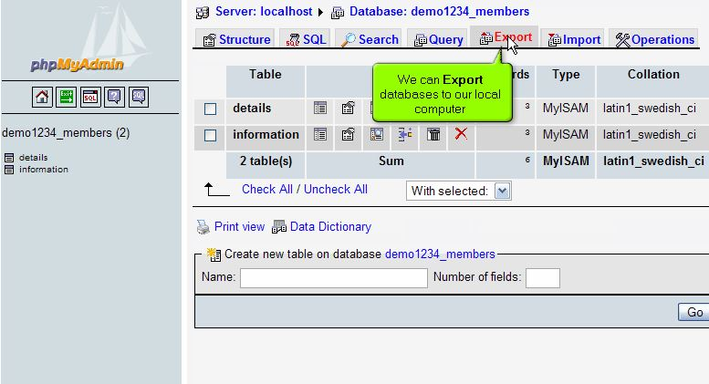
Familiarizing yourself with phpMyAdmin
Export: we can Export databases to our local computer.

Slide 18
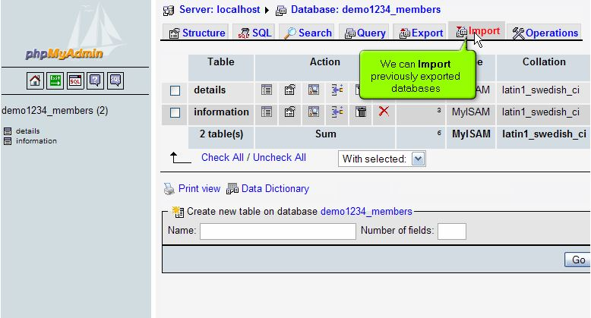
Familiarizing yourself with phpMyAdmin
Import: we can import previously exported databases from local computer into MySQL server..

Slide 19
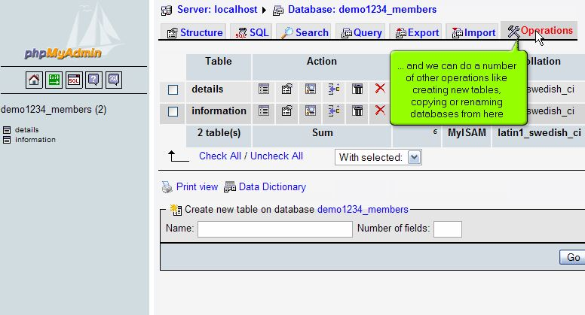
Familiarizing yourself with phpMyAdmin
Operations: we can do a number of other operations like creating new tables copying or renaming databases from here.

Slide 20
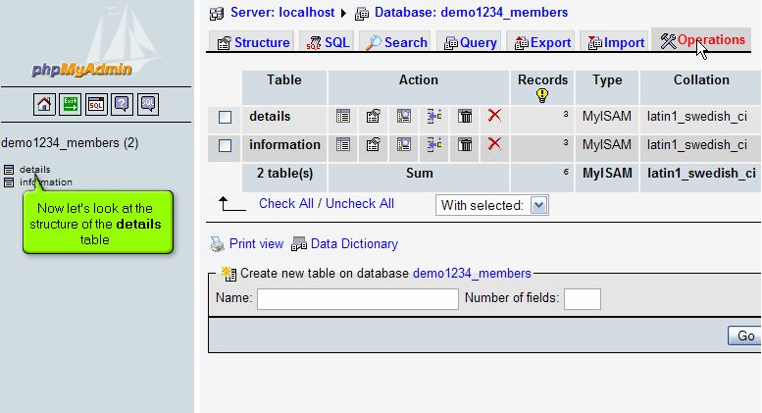
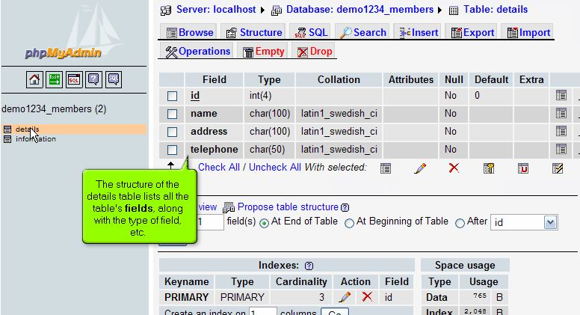
Familiarizing yourself with phpMyAdmin
Now let’s look at the structure of the details table.
The structure of the details table lists all the table’s fields, along with the type of fields etc…
1
2

Slide 21
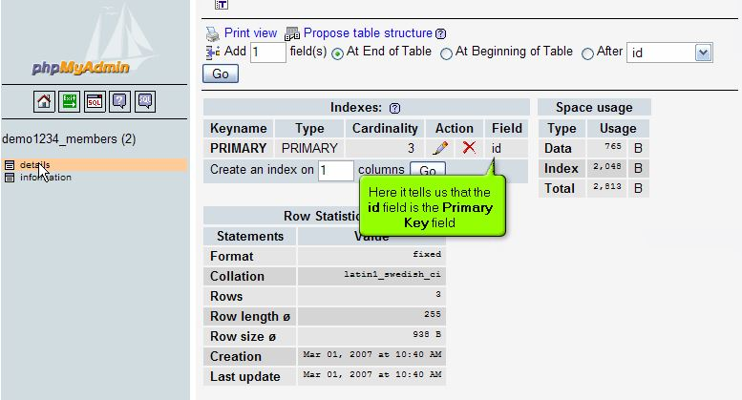
Familiarizing yourself with phpMyAdmin
Indexes: here it tell us that the id field is the primary key field.

Slide 22
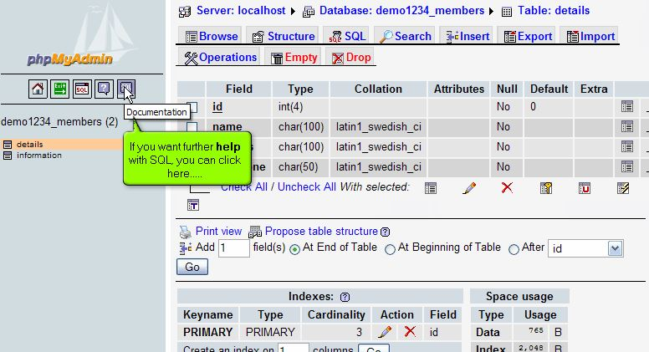
Familiarizing yourself with phpMyAdmin
Documentation: if you want further help with SQL you can click documentation icon...

Slide 23
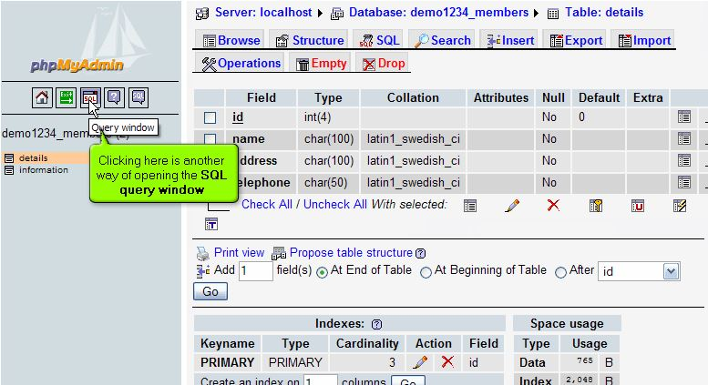
Familiarizing yourself with phpMyAdmin
Clicking here is another way of opening the SQL query window.

Slide 24
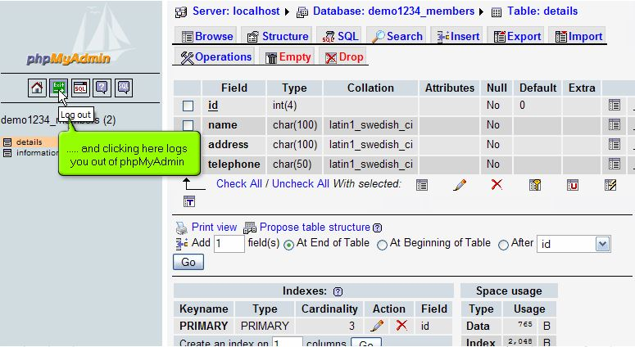
Familiarizing yourself with phpMyAdmin
Logout: clicking here logs you out phpMyAdmin.

Slide 25
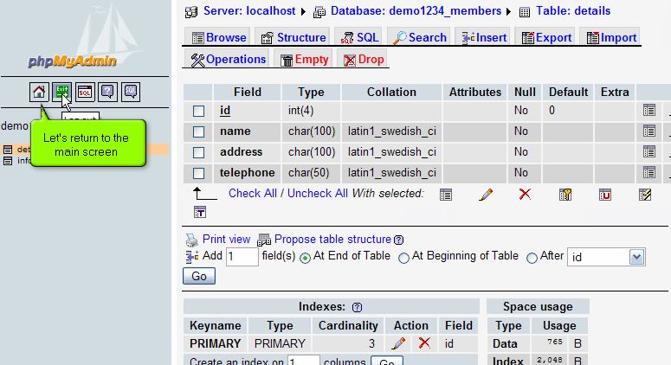
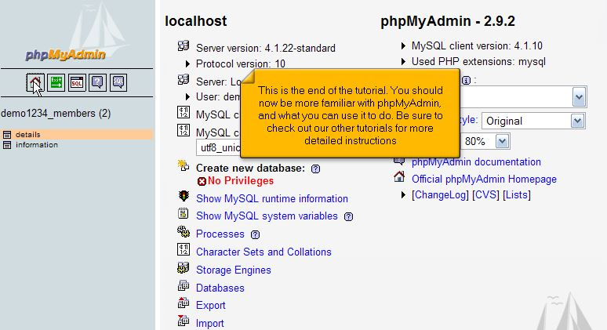
Familiarizing yourself with phpMyAdmin
Let’s return to the main screen by clicking on home icon.
you should now be more familiar with phpMyAdmin, and what you can use it to do.
1
2

Slide 26
Creating tables in a MySQL database with phpMyAdmin

Slide 27
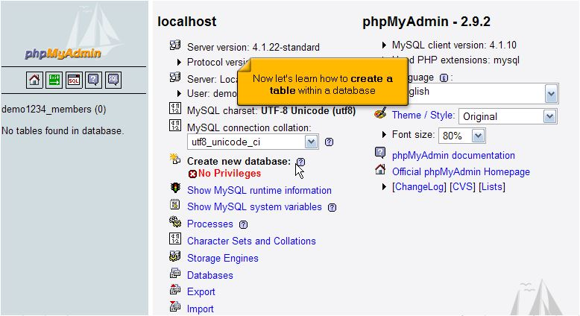
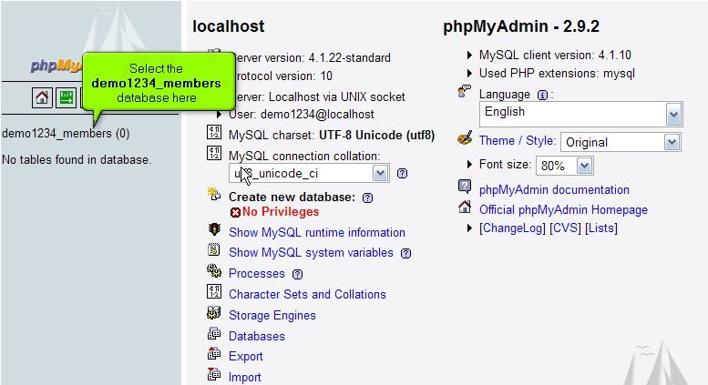
Creating tables in a MySQL database with phpMyAdmin
Now let’s learn how to create a table within a database.
Select the demo1234_members database here.
1
2

Slide 28
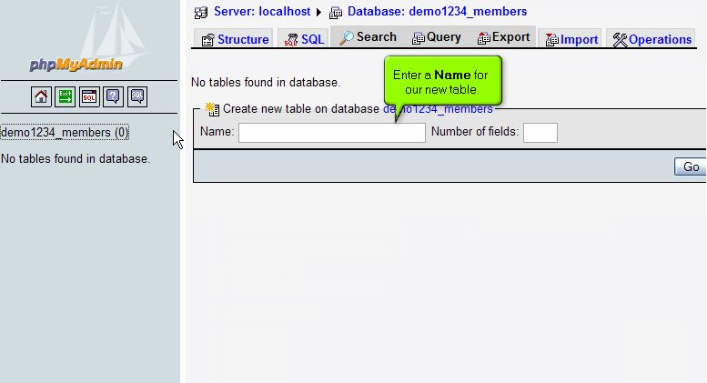
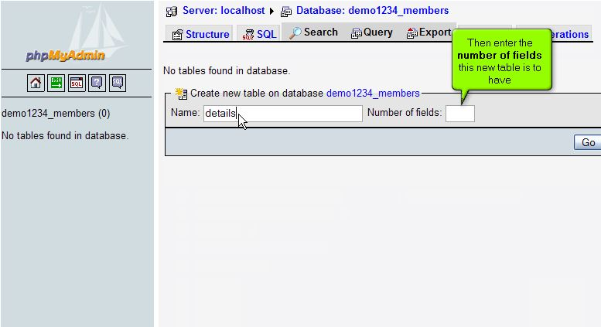
Creating tables in a MySQL database with phpMyAdmin
Enter a Name for our new table.
Then enter the number of fields this new table is to have.
1
2

Slide 29
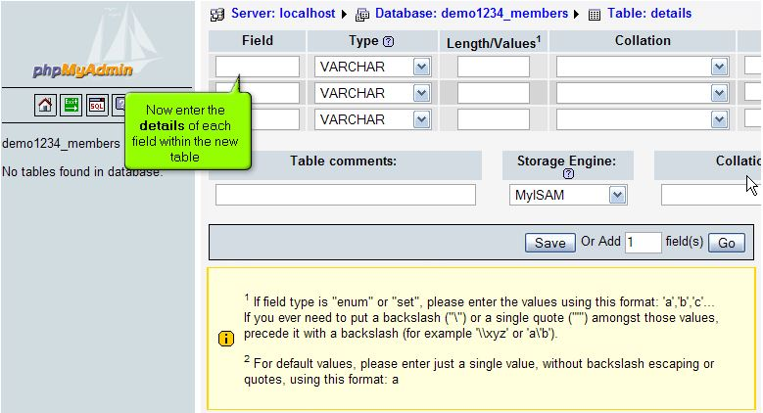
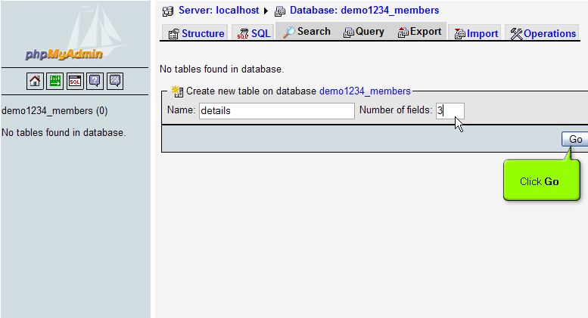
Creating tables in a MySQL database with phpMyAdmin
After entering the number of fields, click go.
Now enter the details of each fields within the new table.
2
1

Slide 30
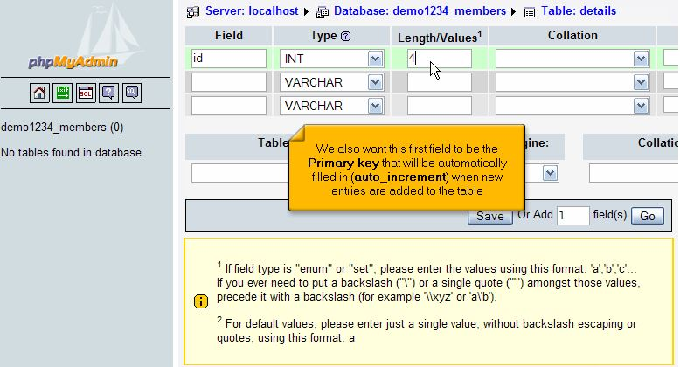
Creating tables in a MySQL database with phpMyAdmin
The first field will be called id and it will be an integer that’s 4 characters in length.
We also want this first field to be the primary key that will be automatically filled in (auto_increment) when new entries are added to the table.

Slide 31
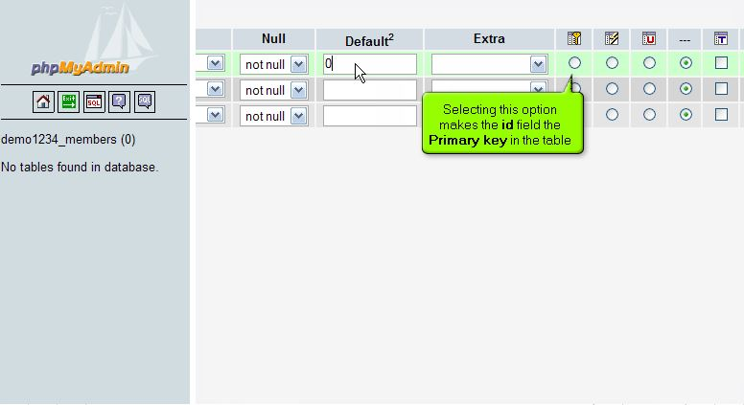
Creating tables in a MySQL database with phpMyAdmin
Selecting this option makes the id field the primary key in the table.

Slide 32
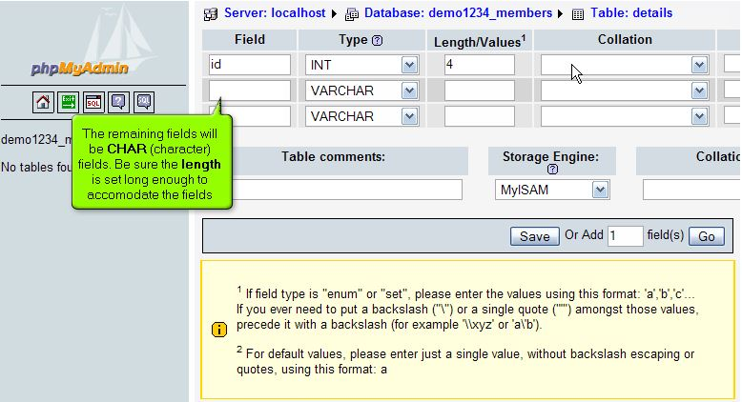
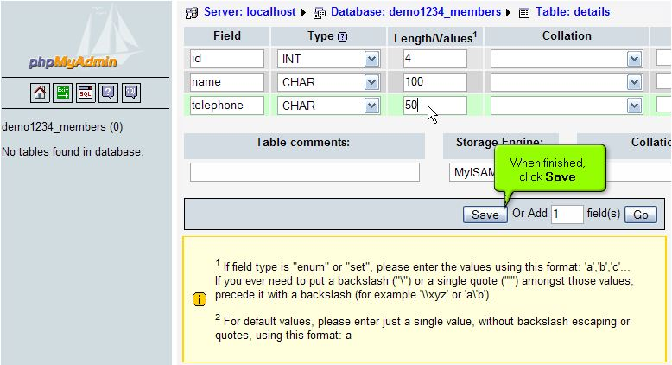
Creating tables in a MySQL database with phpMyAdmin
The remaining fields will be CHAR (character) fields. Be sure the length is set long enough to accommodate the fields.
When finished click Save.

Slide 33
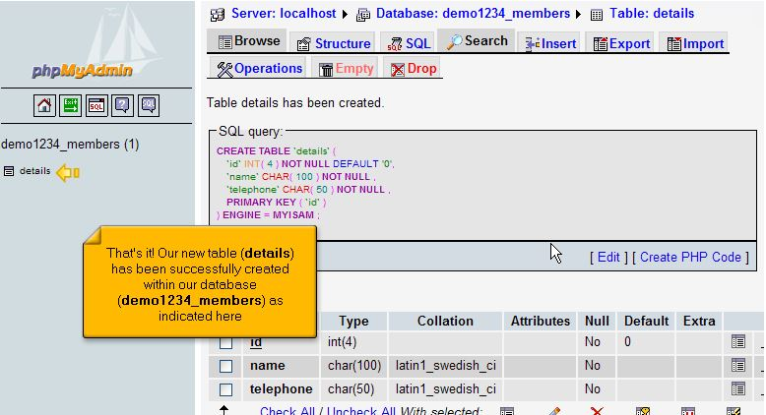
Creating tables in a MySQL database with phpMyAdmin
That’s it!! Our new table (details) has been successfully created within our database (demo1234_members) as indicated here.

Slide 34
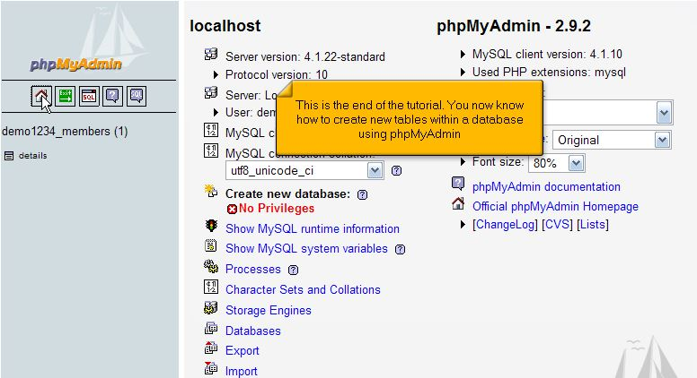
Creating tables in a MySQL database with phpMyAdmin
This is the end of the part 2. You now know how to create new tables within a database using phpMyAdmin.

Slide 35
Deleting tables in a MySQL database with phpMyAdmin

Slide 36
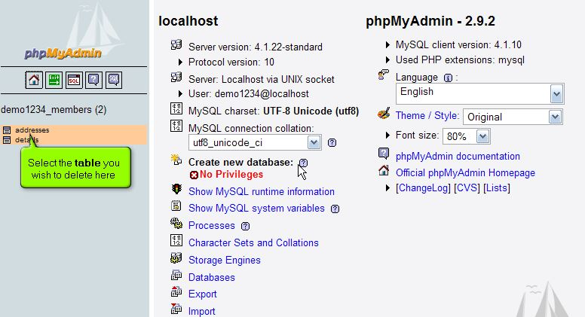
Deleting tables in MySQL database with phpMyAdmin
Now let’s learn how to delete a table from a database.
Select the table you wish to delete here.

Slide 37
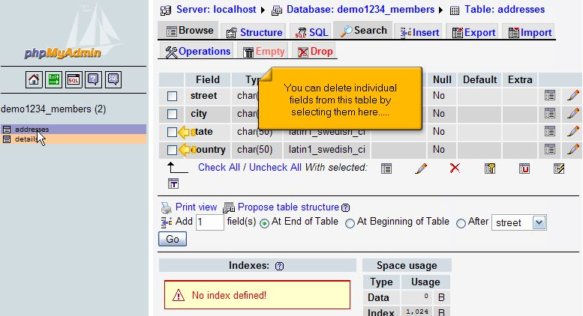
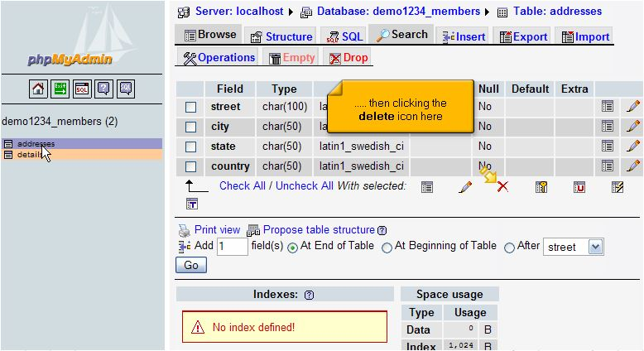
Deleting tables in MySQL database with phpMyAdmin
However in this part we’re going to demonstrate how delete the entire table and everything in it. You can delete individual fields from this table by selecting them here.
then clicking the delete icon here.
1
2

Slide 38
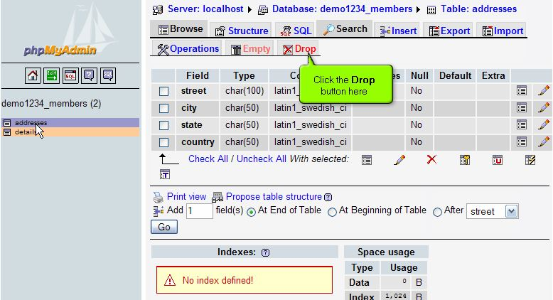
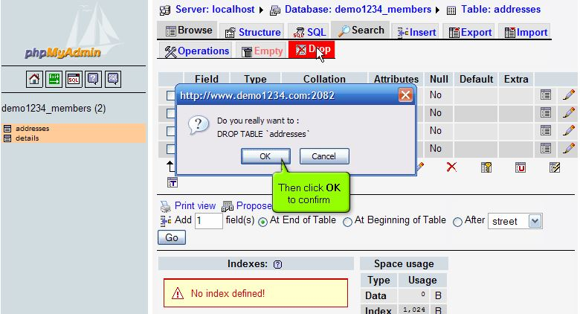
Deleting tables in MySQL database with phpMyAdmin
To delete the table click the Drop button here.
Then click OK to confirm.
1
2

Slide 39
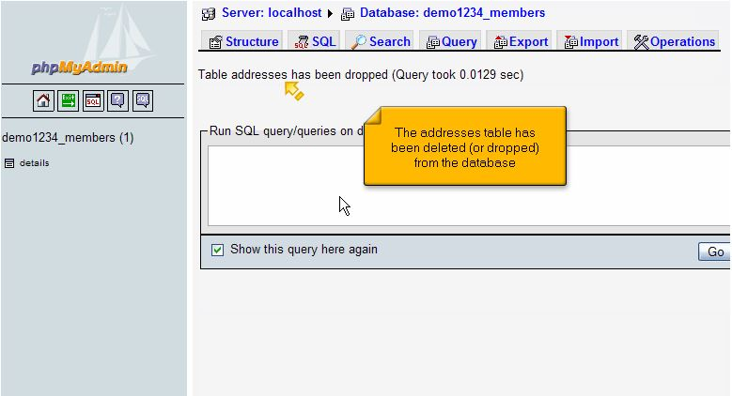
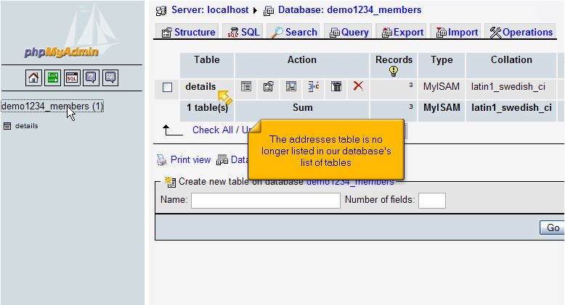
Deleting tables in MySQL database with phpMyAdmin
This addresses table has been deleted (or dropped) from the database.
second screen shows that the addresses table is no longer listed in our databases list of tables.
1
1
2
2

Slide 40
Inserting fields into a MySQL database table using phpMyAdmin

Slide 41
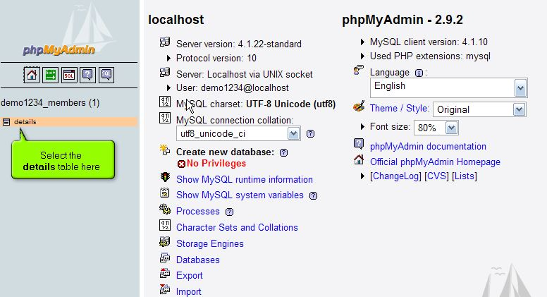
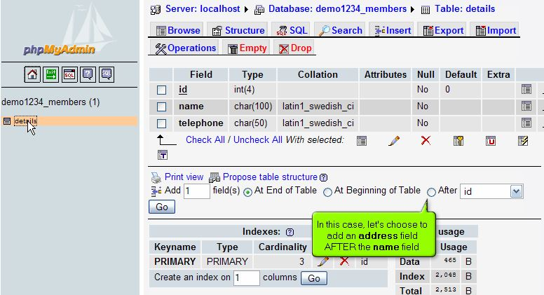
Inserting fields into a MySQL database table using phpMyAdmin
Now let’s learn how to insert fields into database tables.
Select the details table here.
In this case, let’s choose to add an address field AFTER the name field.
1
2

Slide 42
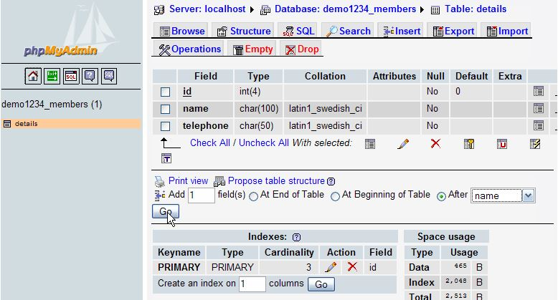
Inserting fields into a MySQL database table using phpMyAdmin
Choose the field (name) and click on the GO.

Slide 43
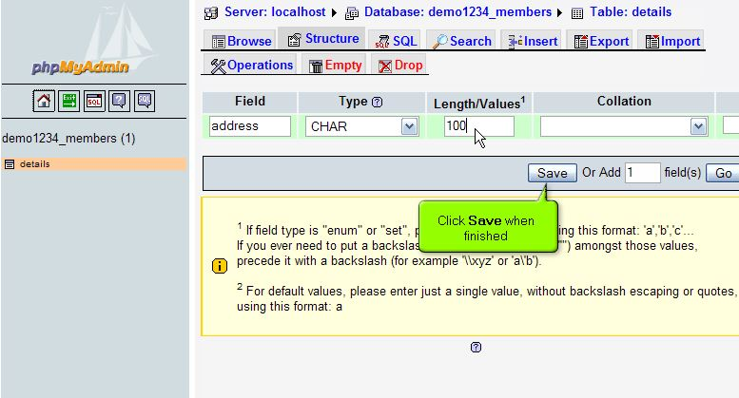
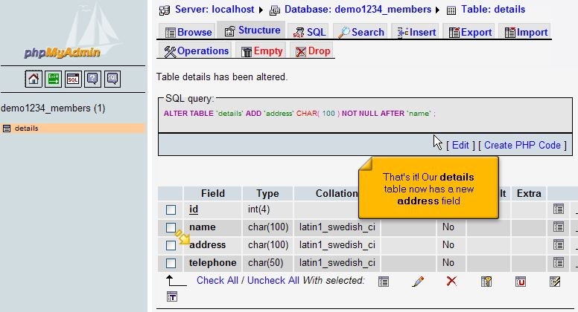
Inserting fields into a MySQL database table using phpMyAdmin
Fill all textboxes and click on finish when finished.
That’s it!! Our details table now has a new address field.
1
2

Slide 44
Modifying fields in a MySQL database table using phpMyAdmin

Slide 45


Modifying fields in a MySQL database table using phpMyAdmin
Now let’s learn how to modify fields in database table.
Select the table (details) here, and let’s modify the address field.
Click the change icon.
1
2

Slide 46


Modifying fields in a MySQL database table using phpMyAdmin
Make the changes you want then click Save.
1
2

Slide 47

Modifying fields in a MySQL database table using phpMyAdmin
That’s it!! We’ve successfully changed the name of the address field to city.
You now know how to modify fields in a table using phpMyAdmin.

Slide 48
Deleting fields in a MySQL database table using phpMyAdmin

Slide 49

Deleting fields in a MySQL database table using phpMyAdmin
now let’s learn how to delete fields from database table, firstly select the details table here.
Let’s delete the city field.

Slide 50


Deleting fields in a MySQL database table using phpMyAdmin
Select the city field, and click the Delete (or Drop) icon.
Click Yes to confirm.
2
1

Slide 51

Deleting fields in a MySQL database table using phpMyAdmin
That’s it!! We’ve successfully deleted the city field from our database table.
You now know how to delete fields in a table using phpMyAdmin.

Slide 52
Exporting and importing MySQL databases and tables using phpMyAdmin

Slide 53

Exporting and importing MySQL database using phpMyAdmin
Now let’s learn how to exporting MySQL databases.
Click the database you wish to export here.
Then click the Export button.

Slide 54


Exporting and importing MySQL database using phpMyAdmin
In this case, we want to export the entire database in SQL format so we can easily import it later. This is a good way to backup your database.
Be sure to check any option you want before proceeding.
2
1

Slide 55


Exporting and importing MySQL database using phpMyAdmin
Check the save as file checkbox then click Go→ ok
that’s it!! The demo1234_member has been exported to our local computer.
1
2

Slide 56


Exporting and importing MySQL database using phpMyAdmin
Now let’s import the saved copy of our database, which includes the details table.
Browse the saved copy of our database (SQL file) and click GO.
1
2
2

Slide 57


Exporting and importing MySQL database using phpMyAdmin
That’s it!! The demo1234_members database has been successfully imported as indicated here. Lets go take a look.
1
2
2
2

Slide 58
Running SQL queries on a MySQL database using phpMyAdmin

Slide 59


Running SQL queries on a MySQL database using phpMyAdmin
Now let’s learn how to run SQL Queries on a database.
Click the database table you wish to run a SQL query on.
Click the SQL button to SQL query window.
1
2

Slide 60

Running SQL queries on a MySQL database using phpMyAdmin
In this part however, let’s demonstrate how to delete this address field using pure SQL command.
Then type the SQL command to delete the address field from the details table. Click Go when finished.

Slide 61


Running SQL queries on a MySQL database using phpMyAdmin
Click OK to Drop address field from the table.
That’s it!! The SQL command has been executed. Let’s go take look.
1

Slide 62

Running SQL queries on a MySQL database using phpMyAdmin
The address field is no longer in our details table.
We now know how to use SQL Query window to SQL syntaxes.
Note: for more information on learning about SQL query syntax, visit the MySQL documentation by clicking on SQL icon..

Slide 63
Searching through a MySQL database using phpMyAdmin

Slide 64

Searching through a MySQL database using phpMyAdmin
Now let’s learn how to use the Search feature.
Click the database you wish to search here. Then click the Search button.
Enter words or values to search for in the database.

Slide 65

Searching through a MySQL database using phpMyAdmin
There are several options you can use to refine your search.
Note: this database only has one table (details), but if there were more, you could limit your search to specific table here..

Slide 66


Searching through a MySQL database using phpMyAdmin
When ready, click Go to perform the search.
The search found one match.
2

Slide 67


Searching through a MySQL database using phpMyAdmin
Click Browse link to look the result.
We can now make changes, delete, export and print to the record that was found .
1
2

